Slide 1

MANAGERS CODEC
UNLOCK YOUR ENTERPRISE
CREATED BY: OLUSEYE AMUSA 2021

Slide 2


ENTERPRISE BUILDING BLOCKS IN A BOX
GAME ASSISTED LEARNING
UNIQUE ENTERPRISE DESIGN THINKING LANGUAGE QUALITATIVE AND QUANTITATIVE REASONING GROUP INTERACTION AND TEAM BUILDING
360 DEGREE ENTERPRISE SIMULATIONS ELEVATOR PITCH DECK MAKING SKILLS UNIQUE SYMBOLIC REPRESENTATION UNIQUE PATTERN RECOGNITION LEARNING THROUGH PLAY GAME ASSISTED LEARNING BUSINESS EDUCATION
LEARNING BY DOING
75% ENGAGEMENT
CREATIVE LOGIC
For more information on JungleNomics and new games visit
www.whatif.com.ng
JungleNomics is a registered Trademark and Patent Pending of IF . Idea Factory Ltd Nigeria 2016

Slide 3
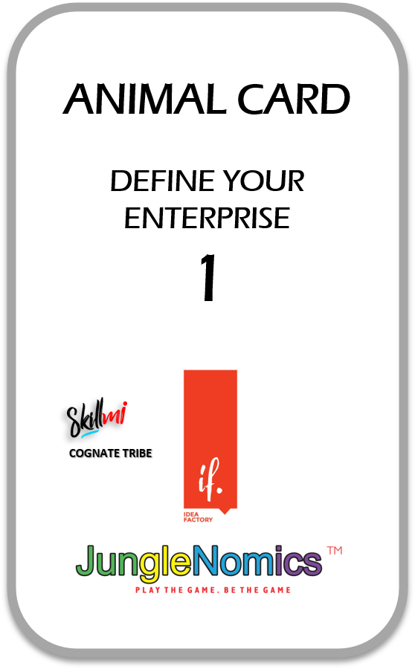
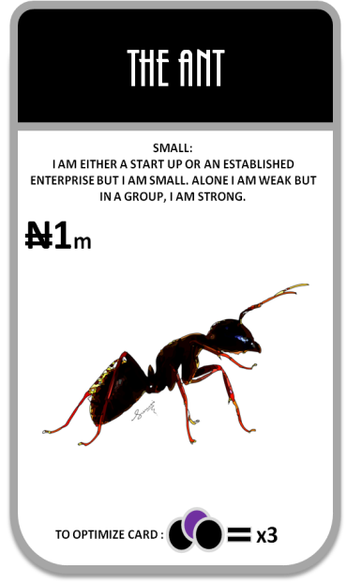
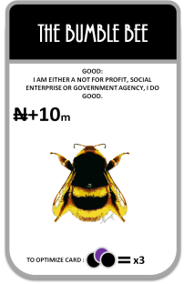
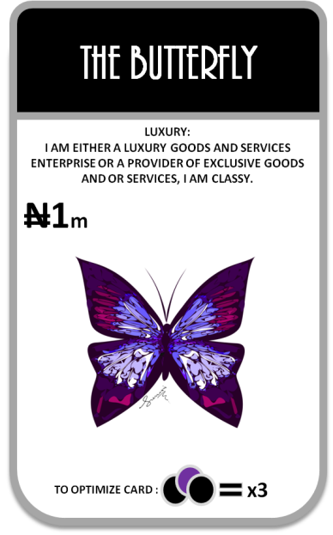
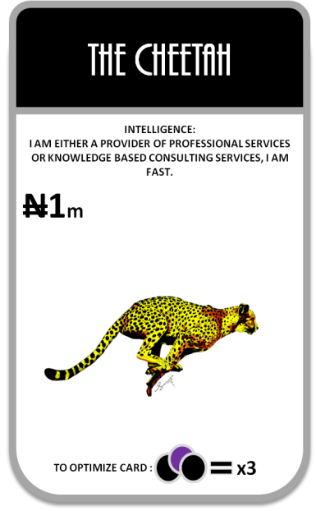

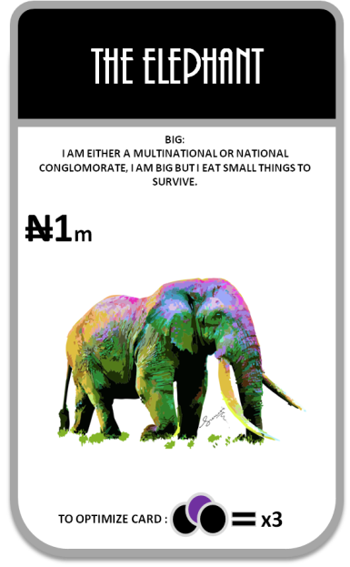
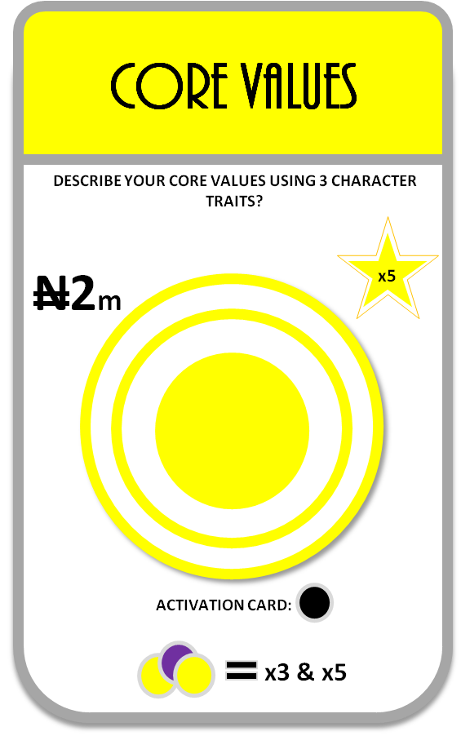
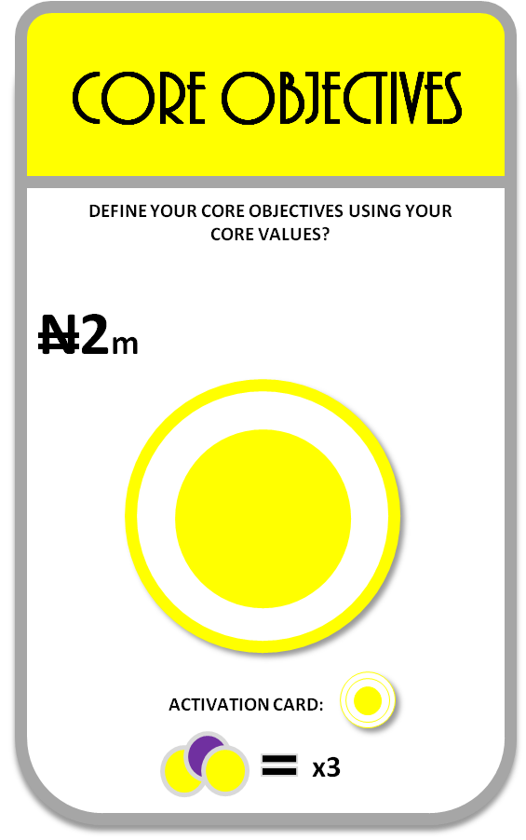
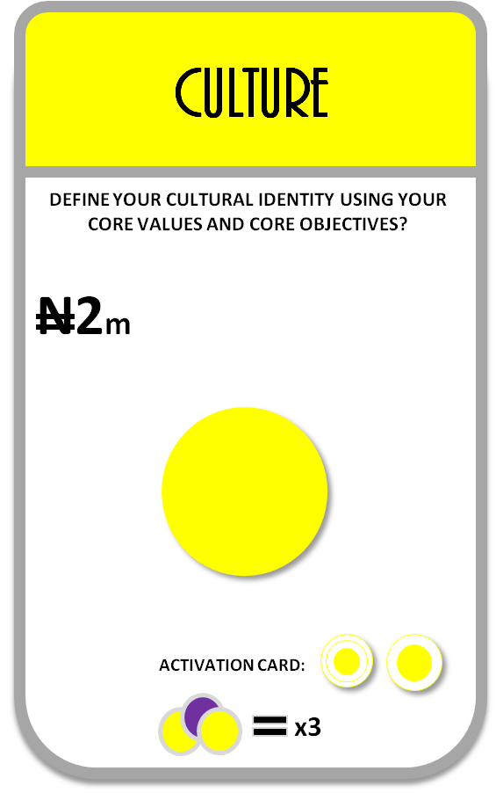
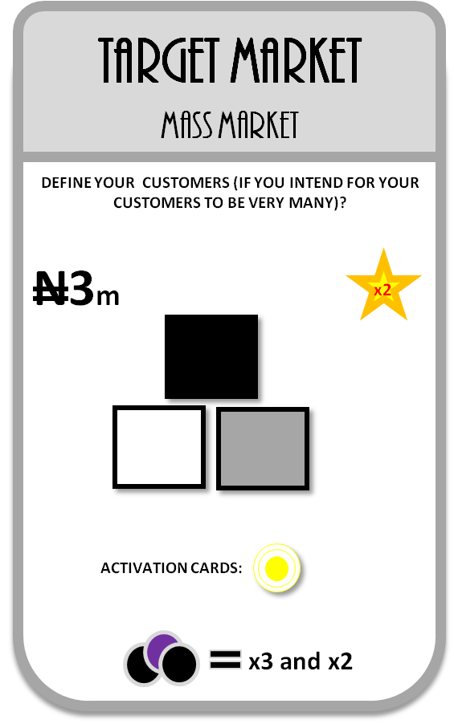

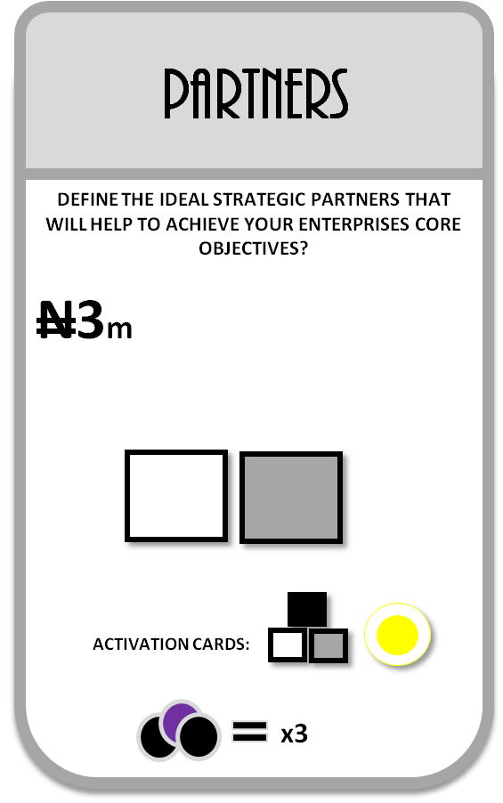
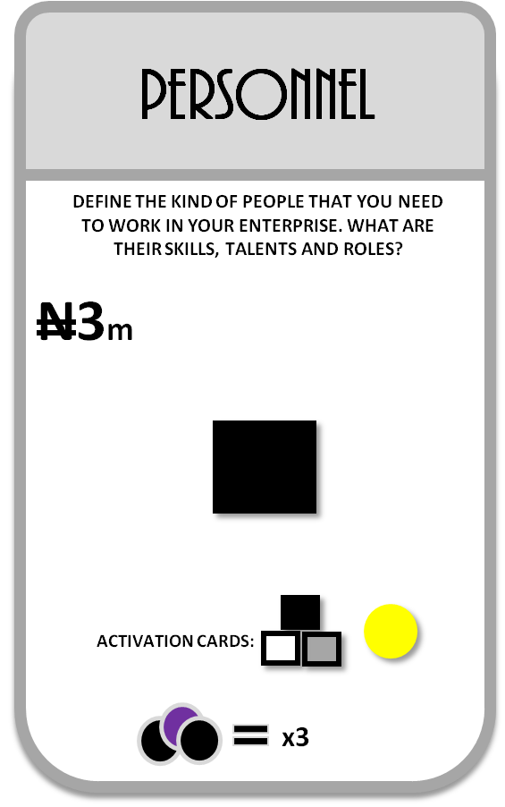
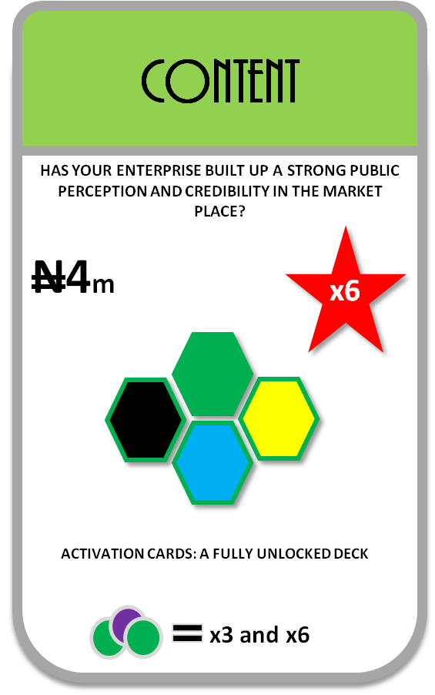
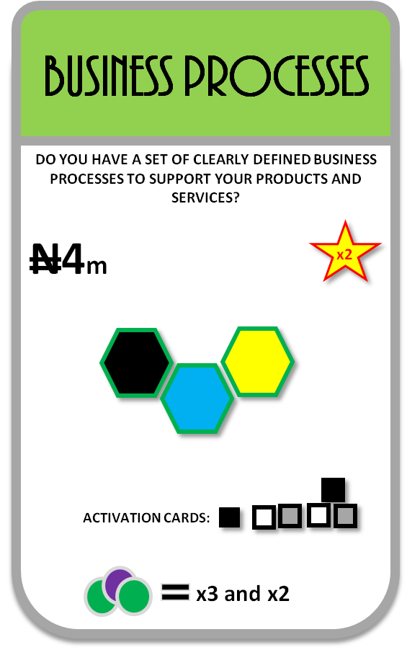
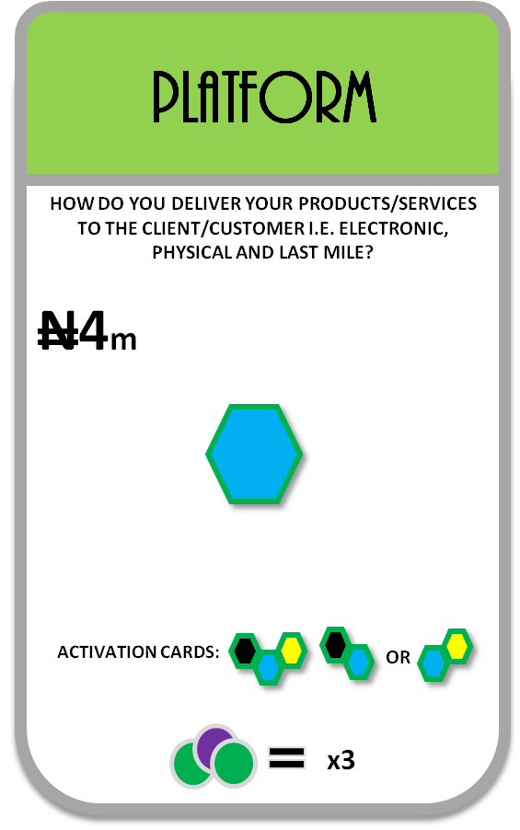
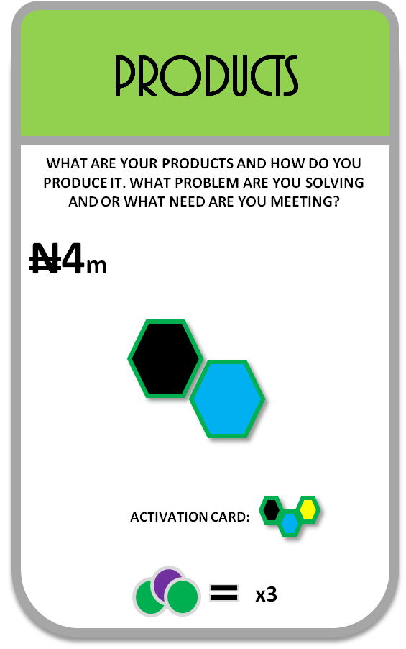
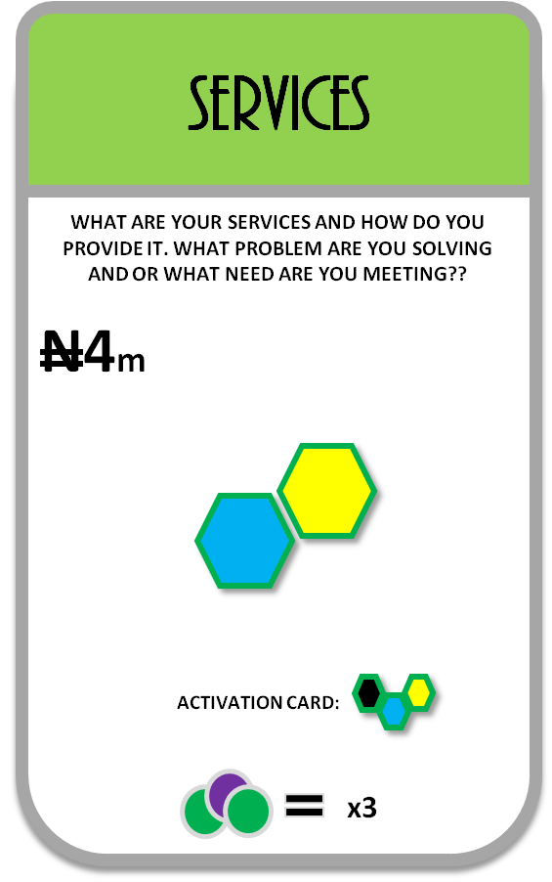
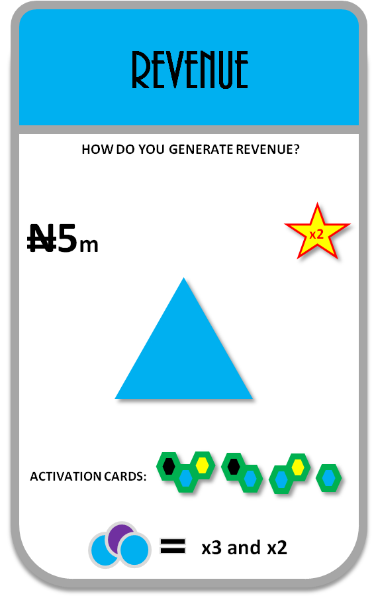
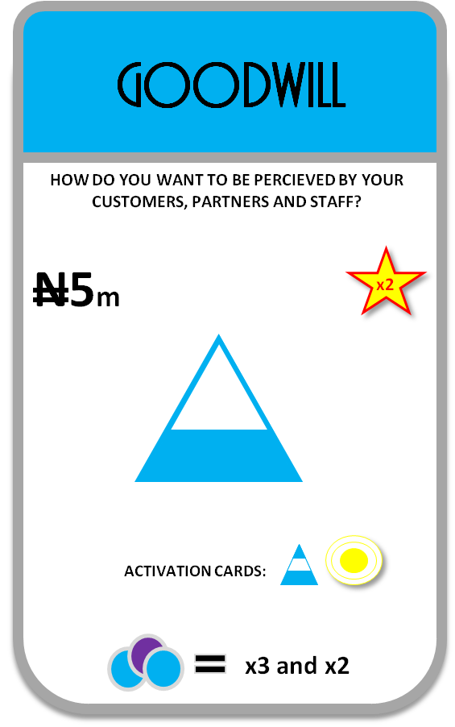
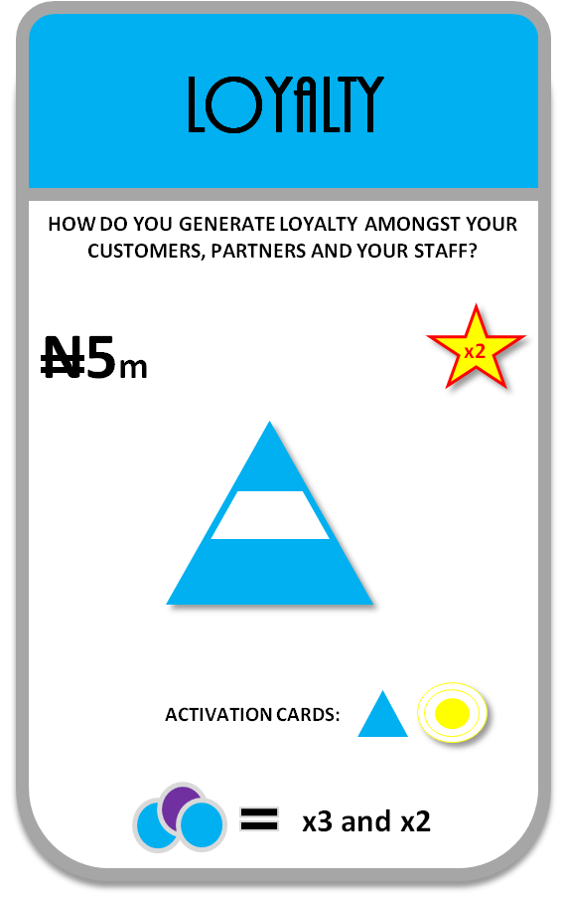
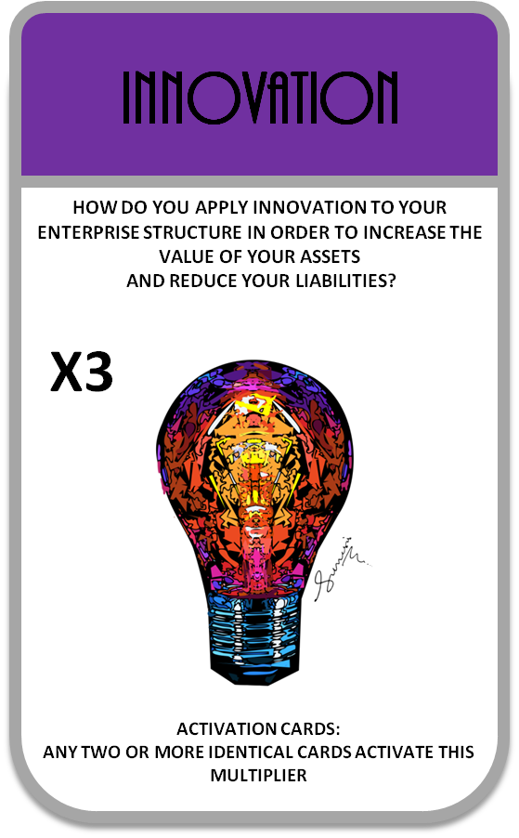
CARD TYPES IN A DECK
CARD TYPOLOGY
DEFINE YOUR ENTERPRISE DNA (INDUSTRY/SECTOR)
WHERE DO YOU WANT TO OPERATE?
+10
+10
+10
+10
+100
+10
DEFINE YOUR: CORPORATE VALUES
WHY ARE YOU DOING IT?
2
+20
+20
+20
DEFINE YOUR: PEOPLE
WHO IS WITH YOU?
3
+15
+15
+15
+15
COMPLIANCE
DEFINE YOUR: SYSTEMS
HOW DO YOU FULFILL PROMISES?
4
+10
+10
+10
+10
+10
DEFINE YOUR: MARKETS
WHAT ARE THE OUTCOMES OF YOUR EFFORTS?
5
+25
+25
+25
DEFINE YOUR: OPTIMIZE VALUE
WHAT MAKES YOU ATTRACTIVE?
6

Slide 4
BUSINESS NARRATIVE PITCH SHEET
CARD TYPES |  | ENTERPRISE NARRATIVE (SUMMARY)
ANIMAL |  | WHAT TYPE OF ENTERPRISE ARE YOU BUILDING? MY ENTERPRISE IS A SMALL BUSINESS THAT SELLS EXPENSIVE JEWWELLRY
RELATIONAL |  | IN ONE SENTENCE DEFINE YOUR CORPORATE VALUES? OUR CORE VALUES ARE …………………… OUR CULTURE IS……………..OUR CORE OBJECTIVESIS/ARE TO…………..
PEOPLE |  | STATE BUSINESS ECOSYSTEM: STAFF STRENGHT, CONTRACTED PARTNERS & TARGET MARKET OUR STRATEGIC PARTNERS ARE……………….OUR TARGET MARKET IS A SELECT/MASS MARKET CONSISTING OF…………………… OUR STAFF CONSISTS OF THE FOLLOWING SKILL USERS………………………..
GIVE |  | STATE BUSINESS SYSTEM: PRODUCTS/SERVICES/PLATFORMS/PROCESSES MY ENTERPISE RUNS ON THE AMAZON AWS PLATFORM………..
GET |  | STATE REVENUE/GOODWILL & LOYALTY TARGETS MY ENTERPRISE IS TARGETING A REVENUE OF …………………..DOLLARS IN THE FIRST QUARTER OF ……………….

Slide 5
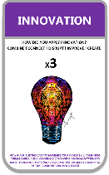

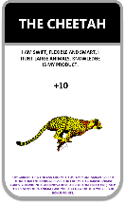
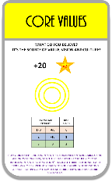
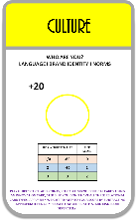
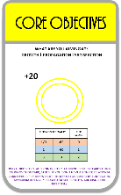
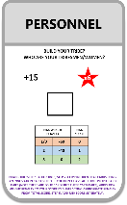
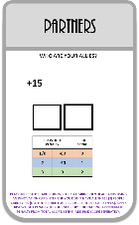
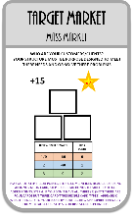
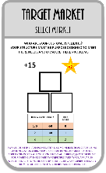
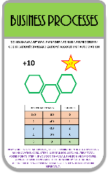
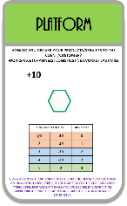
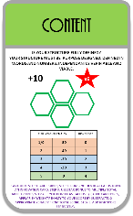
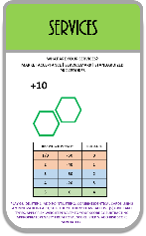
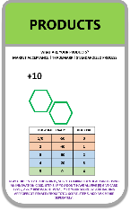
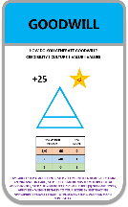
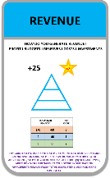
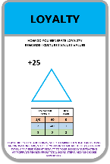
BUSINESS NARRATIVE & SCORE SHEET…SAMPLE
CARD TYPES | ACTIVATED CARDS | ADD POINTS (+) | MULTIPLY BY STAR BONUS (x) | MULTIPLY BY INNOVATION BONUS (x) | SUBTRACT RISK WEIGHT PENALTY (-) | SUB TOTAL | ADD RISK PROFILE SCORE (A HIGH SCORE MEANS LOW RISK AND A LOW SCORE MEANS HIGH RISK)
ANIMAL |  | 10+10 | nil | x3 | nil | 60 | Indicate if wasp card is present.
RELATIONAL |  | 20+20+20+20 | x2 | x3 | nil | 480 | 2
PEOPLE |  | 15+15+15+15+15 | x5 x2 x2 x2 | x3 | nil | 1,620 | 2
SYSTEMS |  | 10+10+10+10+10+10+10 | x6 x2 | X3 x3 | nil | 7,560 | 4
MARKETS |  | 25+25+25+25+25 | x2 x2 x2 | x3 | nil | 3,000 | 2
TOTAL SCORE (CAPITALIZATION) AND (RISK PROFILE) |  |  |  |  |  | 12,720 | 10
RED FLAG: IF WASP IS IDENTIFIED , DIVIDE TOTAL SCORE BY HALF

Slide 6
BUSINESS NARRATIVE & SCORE SHEET…SAMPLE
CARD TYPES | ACTIVATED CARDS | ADD POINTS (+) | MULTIPLY BY STAR BONUS (x) | MULTIPLY BY INNOVATION BONUS (x) | SUBTRACT RISK WEIGHT PENALTY (-) | SUB TOTAL | ADD RISK PROFILE SCORE (A HIGH SCORE MEANS LOW RISK AND A LOW SCORE MEANS HIGH RISK)
ANIMAL |  | 10 | nil | nil | nil | 10 | Indicate if wasp card is present.
RELATIONAL |  | 20+20 | x2 | nil | -40 | 40 | 1
PEOPLE |  | 15+15 | x5 x2 | nil | -40 | 260 | 1
SYSTEMS |  | 10+10 | x6 x2 | nil | -40 | 200 | 1
MARKETS |  | 25 | x2 | nil | -60 | -10 | 0
TOTAL SCORE (CAPITALIZATION) AND (RISK PROFILE) |  |  |  |  |  | 500 | 3
RED FLAG: IF WASP IS IDENTIFIED , DIVIDE TOTAL SCORE BY HALF

Slide 7
USE THIS PUZZLE MAP TO ARRANGE YOUR ACTIVATED CARDS IN THE PROPER ORDER
BACK
START HERE
END HERE

Slide 8


ANIMAL CARDS
COGNATE TRIBES (MINDSET DNA)

Slide 9
THE CARDS HOLD INFORMATION ON THE PARTICULAR ANIMAL TRAIT (ENTERPRISE TYPE)
10.
TRAINING / KNOWLEDGE AREAS
1.
DOMINANT SKILLS / HUMAN RESOURCES
2.
MACRO / MICRO ENVIRONMENT ANALYSIS
COGNATE TRIBE CARD TOPOLOGY
ANIMAL CARDS
(ENTERPRISE TYPOLOGY)
MIND SET
9.
RISK MANAGEMENT PROFILE
COGNATE TRIBE
3.
START UP & REGULATORY REQUIREMENTS
8.
STRATEGY TOOLS: BUSINESS MODEL CANVAS, SWOT/PORTERS 5 FORCES ETC
4.
MARKETING STRATEGY (ENTRY/CONSOLIDATION/DOMINATION & EXIT)
7.
ANALYTICS & BIG DATA
5.
BRANDING, CULTURAL TRAITS & TRENDS
6.
APPLICATION OF TECHNOLOGY (AI,ROBOTICS, IOT ETC)

Slide 10
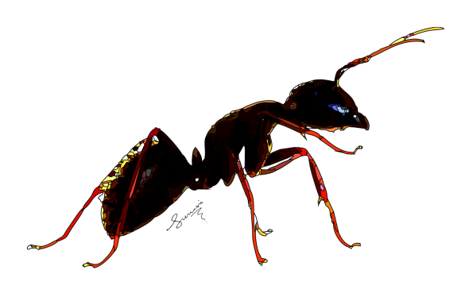
THE ANT
CORPORATE PERSONA | MIND SET | BOX ANALYSIS
BUILDER OF BUSINESSES | LIKES NEW THINGS AND EXPERIANCES AND PROJECTS | LIKES TO BUILD BOXES LIKES TO THINK OUTSIDE THE BOX NOT COMFORTABLE IN LARGE BOXES NEEDS TO EVOLVE MINDSET TO SCALE BOXES
THRIVES IN HARSH ENVIRONMENTS | BREACKS RULES, MAKES RULES
START UP INDUSTRY EXPERIANCED | CHARISMATIC – A STORYTELLER
PROCESS EXPERIANCED | A COMMUNITY BUILDER
START AND RESTART CAPABLE | MAY NOT BE COMFORTABLE IN A STRUCTURED ENVIRONMENT
TEAM BUILDER (MAGNETIC PERSONALITY) | MAY NOT BE ABLE TO SCALE PAST A CERTAIN THRESHOLD
I AM A BUILDER OF ECONOMIES; I AM WEAK ON MY OWN BUT STRONG IN A GROUP. EVERYONE STARTS WITH ME!
+10
INSIGHT | MULTI INDUSTRY EXPERIENCE CREATES OPPORTUNITIES FOR INNOVATION. THEY MIGHT NOT REALIZE THIS THOUGH
TO OPTIMIZE CARD :
x3

Slide 11
ANT
You are interested in Small Enterprises or start ups, you either plan to start your own business one day or you have already started. You have dreams of appearing on the cover of Fortune or Times Magazine, you are not satisfied with where you are right now. You have the heart of a creator

Slide 12

THE BUTTERFLY
CORPORATE PERSONA | MIND SET | BOX ANALYSIS
EXCLUSIVE PRODUCTS | VALUE ENHANCER | LIKES EXCLUSIVE BOXES IS NOT COMFORTABLE WITH OUTSIDE THE BOX THINKING VERY COMFORTABLE IN LARGE BOXES IF THERE IS CLOSE ACCESS TO THE MANAGEMENT CARDE
THRIVES IN AN UPPER CLASS CONSCIUS ENVIRNMENT | SPECIAL TREATMENT
LUXURY GOODS OR SERVICES INDUSTRY EXPERIANCED | POPU;AR AND FLASHY
IRRATIONAL MARKETING & SALES EXPERIANCE | SMALL MARKETS, SMALL COMMUNITIES HIGH NET WORTH
FAMILIAR WITH THE UNIQUE DEMANDS OF HIGH-END CUSTOMERS | IS NOT COMFORTABLE FACING MASS MARKETS
TEAM PLAYER (MUST BE THE TOP TEAM THOUGH) | NOT COMFORTABLE WITH ADVERSITY OR FAILED PROJECTS (ANYTHING THAT MIGHT CAUSE A CLASS DOWNGRADE)
I AM EXCLUSIVE, EXPENSIVE, CUSTOMIZED AND RARE!
+10
INSIGHT | MULTI INDUSTRY EXPERIENCE CREATES OPPORTUNITIES FOR INNOVATION. THEY MIGHT NOT REALIZE THIS THOUGH
TO OPTIMIZE CARD :
x3

Slide 13
BUTTERFLY
You are interested in Luxury and Exclusive Enterprises. You appreciate the finer things and understand that not everyone can get them. You are either planning to work in a Luxury/exclusive product/service Firm or already working in one. You are fascinated by class and privileged and how exclusivity is generated. You have a Royal Heart.

Slide 14

THE BUMBLE BEE
CORPORATE PERSONA | MIND SET | BOX ANALYSIS
NOT FOR PROFIT / GOVERNMENTAL | A GIVER | LIKES PORPOSEFUL BOXES LIKES TO BUILD BOXES NOT COMFORTABLE IN LARGE BOXES
THRIVES IN AN IMPACT DRIVEN ENVIRONMENT | WANTS TO THE SOCIETY
PRODUCTS AND OR GOODS THAT ARE INTANGIBLE | OPINIONATED
PURPOSE DRIVEN OUTCOMES | EVANGELIST ON A MISSION
PEOPLE CENTRIC PROGRAMS | MAY NOT BE COMFORTABLE WITH PURELY PROFIT-MAKING OBJECTIVES
TEAM PLAYER (IF THE TEAM ACTS LIKE A FAMILY) | NOT COMFORTABLE WITH BACK-END WORK, WANTS TO BE IN THE FRONT LINES
I AM A GIVER AND A PROPAGATOR OF SOCIAL GOOD!
+10
INSIGHT | MULTI INDUSTRY EXPERIENCE CREATES OPPORTUNITIES FOR INNOVATION. THEY MIGHT NOT REALIZE THIS THOUGH
TO OPTIMIZE CARD :
x3

Slide 15
BUMBLE BEE
You are interested in Benevolent Enterprises. You are willing to give and share to help the less privileged and you hold yourself up to a high standard of ethical and moral values. You are either planning to work in an NGO or Social Enterprise or are already working in one. You may be also Planning to integrate a give back Campaign for your Enterprise or have already done so. You have a Crusaders Heart.

Slide 16

THE CHEETAH
CORPORATE PERSONA | MIND SET | BOX ANALYSIS
PROFESSIONAL ENVIRONMENT | A PHILOSOPHER | LIKES THINKING OUTSIDE THE BOX DOES NOT LIKE CLOSED BOXES LIKES BUILDING NEW BOXES HAS A LOT OF UN-COMPLETED BOXES LYING AROUND
THRIVES IN ORGANIZED FAST PACED ENVIRONMENTS | A TEACHER
PROCESS DRIVEN OUTCOMES | THEORY DRIVEN
HIGH MOTIVATION DRIVEN | TINKERER
KNOWLEDGE DRIVEN | MUST ALWAYS BE INNOVATING NOT STRONG ON IMPLEMENTATION
TEAM PLAYER (COMPARATIVE SKILL SETS) | GETS EASILY BORED WITH BACK-END PROCESSES
I AM SWIFT, FLEXIBLE AND SMART, I HUNT LARGE ANIMALS. KNOWLEDGE IS MY PRODUCT.
+10
INSIGHT | MULTI INDUSTRY EXPERIENCE CREATES OPPORTUNITIES FOR INNOVATION. THEY MIGHT NOT REALIZE THIS THOUGH
TO OPTIMIZE CARD :
x3

Slide 17
CHEETAH
You are interested in Knowledge Enterprises, and you see yourself as a maverick with ideas that will change the world. You are either planning to work in a Knowledge Firm or You are already working in one. An unconventional thinker and like puzzles and intelligent discourse. You do not suffer fools gladly. You have a Teachers heart.

Slide 18
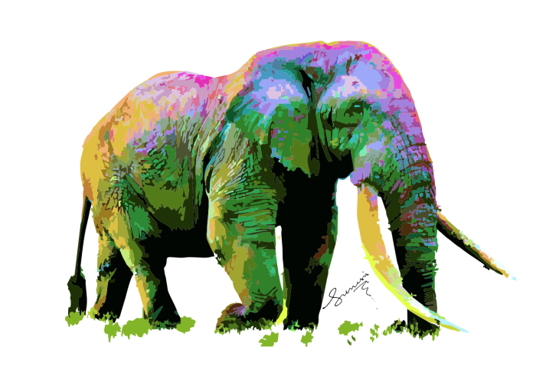
THE ELEPHANT
CORPORATE PERSONA | MIND SET | BOX ANALYSIS
HIGHLY STRUCTURED AND LARGE CORPORATIONS | A CORPORATE CITIZEN | LOVES BIG BOXES LOVES CLOSED BOXES LIKES TO BE IN A SMALL BOX INSIDE BIG BOXES
HIGHLY ORGANIZED WORK ENVIRONMENT | FOLLOWS INSTRUCTION
VERY BIG ON DOCUMENTATION AND INSTRUCTIONS | COMFORTABLE WITH REGIMENTATION
VERY BIG ON TITLES AND CORPORATE POSITION | PYRAMID BUILDER
INCENTIVE DRIVEN | NOT COMFORTABLE WITH INNOVATION AND CREATIVE THINKING UNLESS IT’S A CLEARLY DEFINED ROLE
TEAM PLAYER (AS LONG AS ROLES AND RESPONSIBILITIES ARE CLEARLY DEFINED) | NOT COMFORTABLE WITH OPEN ROLES OR SITUATIONAL LEADERSHIP
I AM HUGE, SLOW, STRONG AND STRUCTURED, NEVERTHELESS, I FEED ON LITTLE THINGS TO SURVIVE!
+10
INSIGHT | MULTI INDUSTRY EXPERIENCE CREATES OPPORTUNITIES FOR INNOVATION. THEY MIGHT NOT REALIZE THIS THOUGH
TO OPTIMIZE CARD :
x3

Slide 19
ELEPHANT
You are interested in Large Enterprises and how they work, you are either planning to work with a large enterprise or are already working in one. You are ambitious, driven and fascinated with corporate culture and you see yourself on the Board of a large company one day. You have Builder's heart.

Slide 20

THE WASP
CORPORATE PERSONA | MIND SET | BOX ANALYSIS
ORGANIZED CRIME | A THIEF | PARASITIC TO BOXES DOES NOT LIKE TO BUILD BOXES BUT LOVES TO TEAR THEM DOWN FROM WITHIN HAS A LOT OF BROKEN BOXES LYING AROUND IN PAST
THIVES IN ADMINISTRATIVE LOOPHOLES | A LIAR
THRIVES IN HIGHLY POLITICISED ENVIRONMENTS | A DECIEVER
THRIVES IN STAGNATED ROLES | A DESTROYER
GREED DRIVEN | WANTS TO BE LIKED AND ADMIRED
LONE WOLF (UNLESS WORKING IN A WOLF PACK) | AVOIDS OVERSITE AS MUCH AS POSSIBLE
I AM A TAKER, DISTROYER AND A PARASITE, I CONVERT GOOD TO BAD, NOBODY LIKES ME!
+100
INSIGHT | PAST HISTORY IS FULL OF DYSFUNCTION BUT THEY ARE ALWAYS THE GOOD GUYS IN EVERY STORY
TO OPTIMIZE CARD :
x3

Slide 21
WASP
Selfish and full of schemes to subvert systems and processes, thrives in chaos and thus will oppose any effort to improve system efficiency and transparency, feeds off process loopholes and grows in an environment full of dis unity.
Has the heart of a traotor

Slide 22
SKILL CARDS
ICE (INTEREST CAPTURE ENGINE)

Slide 23
THE CARDS HOLD INFORMATION ON THE PARTICULAR SKILLS AND KNOWLEDGE AREAS (BUILDING BLOCKS)
1.
0 CONCEPTUAL
(IDEAS, MODELS & PLANS)
10.
KNOWLEDGE AREAS
(NEEDS IDENTIFICATION & ASSESSMENT)
2.
- DISCONNECT
(NO VALUE ADD RELATIONSHIP)
SKILL CARDS TOPOLOGY
RELATIONAL
(CORPORATE VALUES)
PEOPLE
(BUSINESS ECOSYSTEM)
GIVE
(BUSINESS SYSTEMS)
GET
(THE MARKETPLACE)
SKILL SET
9.
SKILL SETS
(NEEDS IDENTIFICATION & ASSESSMENT)
INTEREST CAPTURE ENGINE
3.
+ CONNECT
(CASH BASED VALUE ADD RELATIONSHIPS)
8.
< WEAKER THAN ENVIRONMENTAL
(UNDER INFLUENCE INTERNAL ENVIRONMENTAL IS WEAKER THAN EXTERNAL ENVIRONMENT)
4.
x SYNERGY
(VALUES BASED VALUE ADD RELATIONSHIPS)
7.
= EQUILIBRIUM TO ENVIRONMENTAL
(EQUAL STRENGHT, INTERNAL ENVIRONMENT & INTERNAL ENVIRONMENT ARE EQUAL)
6.
> STRONGER THAN ENVIRONMENTAL
(IN CONTROL, INTERNAL ENVIRONMENT IS STRONGER THAN EXTERNAL ENVIRONMENT)
5.
/ DYSFUNCTION
(NEGATIVE VALUE ADD RELATIONSHIP)

Slide 24
CORE VALUES
CORE VALUES JOB FUNCTIONS
SKILL/CAREERS- HUMAN RESOURCE, AUDIT, COMPANY SECRETARY, CONTROL, REGULATORY AGENCY PROFESSIONAL.
WHAT DO YOU BELIEVE?
IT’S THE SOURCE OF VALUE, VISION AND CULTURE!
+20
x2
RISK WEIGHT PENALTY |  | RISK SCORE
1/0 | -60 | 0
2 | -40 | 1
3 | 0 | 2
INSIGHT | MULTI INDUSTRY EXPERIENCE PROVIDES AN OPPORTUNITY TO DISCOVER INNOVATIVE INSIGHTS, THINK ABOUT THIS
KEY:
x3 & x5

Slide 25
CULTURE
CULTURE JOB FUNCTIONS
SKILL/CAREERS- HR, TRAINING, POLICY FORMULATION, FASHION, QUALITY CONTROL, COMPLIANCE, TREND ANALYSIS, POPULAR CULTURE, RELIGION, CORPORATE COMMUNICATIONS.
WHO ARE YOU?
LANGUAGE I BRAND IDENTITY I NORMS
+20
RISK WEIGHT PENALTY |  | RISK SCORE
1/0 | -60 | 0
2 | -40 | 1
3 | 0 | 2
INSIGHT | SEEK AN UPGRADE WITH CORE VALUE AND CORE OBJECTIVE SKILL SETS.
KEY:
x3

Slide 26
CORE OBJECTIVES
CORE OBJECTIVES JOB FUNCTIONS
SKILL/CAREERS- PROJECT MANAGEMENT, SCRUM MASTER, ISO AUDITOR, BUSINESS PLANNING, ACCOUNTING, LEGAL
WHAT ARE YOU AIMING AT?
GROWTH I PROPAGATION I SATISFACTION
+20
RISK WEIGHT PENALTY |  | RISK SCORE
1/0 | -60 | 0
2 | -40 | 1
3 | 0 | 2
INSIGHT | SEEK AN UPGRADE WITH CORE VALUE SKILL SETS.
KEY:
x3

Slide 27
RELATIONAL CARDS: SKILL SETS
CORE VALUES: Skill/Careers- HR, Audit, Company Secretary, Control, Regulatory Agency Professional. CORE OBJECTIVES: Skill/Careers- Project Management, ISO Auditor, Business Planning, Accounting, Legal. CULTURE: Skill/Careers- HR, Training, Policy Formulation, Fashion, Quality Control, Compliance, Trend Analysis, Popular Culture, Religion, Corporate Communications.

Slide 28
PERSONNEL
PERSONNEL JOB FUNCTIONS
SKILL/CAREERS- HR, TRAINING, LEGAL, POLICY FORMULATION, SEARCH & SELECTION, TESTING, CERTIFICATION TRAINING, OUTSOURCING, IN SOURCING, ALL HUMAN RESOURCE MANAGEMENT CERTIFICATIONS.
BUILD YOUR TRIBE?
WHO ARE YOUR TRIBESMEN/WOMEN?
+15
x6
RISK WEIGHT PENALTY |  | RISK SCORE
1/0 | -60 | 0
2 | -40 | 1
3 | 0 | 2
KEY:
INSIGHT | SEEK AN UPGRADE COMBO WITH TARGET MARKET SKILL SETS AND NOTE: MULTI INDUSTRY EXPERIENCE IS AN ADDED BONUS
x3

Slide 29
PARTNERS
PARTNERS JOB FUNCTIONS
SKILL/CAREERS- LEGAL, FINANCIAL ANALYST, NEGOTIATIONS, MARKETING, CORPORATE COMMUNICATIONS, BUSINESS FORECASTING.
WHO ARE YOUR ALLIES?
+15
RISK WEIGHT PENALTY |  | RISK SCORE
1/0 | -60 | 0
2 | -40 | 1
3 | 0 | 2
INSIGHT | SEEK AN UPGRADE COMBO WITH TARGET MARKET & CORE OBJECTIVES SKILL SETS AND NOTE, MULTI INDUSTRY EXPERIENCE IS AN ADDED BONUS
KEY:
x3

Slide 30
TARGET MARKET
MASS MARKET
TARGET MARKET MASS MARKET JOB FUNCTIONS
SKILL/CAREER- MARKETING, PRODUCT RESEARCH & DEVELOPMENT, USER EXPERIENCE (IX), SOCIOLOGY, ECONOMIC ANALYSIS, PSYCHOLOGY, PRODUCT/SERVICE DESIGN, SALES, COMMUNITY DEVELOPMENT, TREND ANALYSIS, CORPORATE COMMUNICATIONS.
WHO ARE YOUR CUSTOMERS/CLIENTS?
YOUR STRUCTURE MUST BE PURPOSE DESIGNED TO MEET THERE NEEDS AND OR SOLVE THEIR PROBLEMS
+15
x2
RISK WEIGHT PENALTY |  | RISK SCORE
1/0 | -60 | 0
2 | -40 | 1
3 | 0 | 2
INSIGHT | SEEK AN UPGRADE COMBO WITH CORE VALUES SKILL SETS AND NOTE, MULTI INDUSTRY EXPERIENCE IS AN ADDED BONUS
KEY:
x3 and x2

Slide 31
TARGET MARKET
SELECT MARKET
TARGET MARKET SELECT JOB FUNCTIONS
SKILL/CAREER- MARKETING, PRODUCT RESEARCH & DEVELOPMENT, USER EXPERIENCE (IX), SOCIOLOGY, ECONOMIC ANALYSIS, PSYCHOLOGY, PRODUCT/SERVICE DESIGN, SALES, COMMUNITY DEVELOPMENT, TREND ANALYSIS, CORPORATE COMMUNICATIONS.
WHO ARE YOUR CUSTOMERS/CLIENTS?
YOUR STRUCTURE MUST BE PURPOSE DESIGNED TO MEET THERE NEEDS AND OR SOLVE THEIR PROBLEMS
+15
x2
RISK WEIGHT PENALTY |  | RISK SCORE
1/0 | -60 | 0
2 | -40 | 1
3 | 0 | 2
INSIGHT | SEEK AN UPGRADE COMBO WITH CORE VALUES SKILL SETS AND NOTE, MULTI INDUSTRY EXPERIENCE IS AN ADDED BONUS
KEY:
x3 and x2

Slide 32
PEOPLE CARDS: SKILL SETS
PERSONNEL: Skill/Careers- HR, Training, Legal, Policy Formulation, Search & Selection, Testing, Certification Training, Outsourcing, In sourcing, All Human Resource Management Certifications. PARTNERS: Skill/Careers- Legal, Financial Analyst, Negotiations, Marketing, Corporate Communications, Business Forecasting. CLIENT/CUSTOMER (MASS & SELECT): Skill/Career- Marketing, Product Research & Development, User Experience (IX), Sociology, Economic Analysis, Psychology, Product/Service Design, Sales, Community Development, Trend Analysis, Corporate Communications.

Slide 33
COMPLIANCE
COMPLIENCE JOB FUNCTIONS
SKILL/CAREER- REGULATORY COMPLIANCE, AUDIT & CONTROL, THE BOARD.
IS YOUR STRUCTURE FULLY DEFINED?
YOUR STRUCTURE MUST BE PURPOSE DESIGNED, DEFINED IN WORDS AND NUMBERS, INDEPENDANTLY VERIFIABLE AND VIABLE.
+10
x10
RISK WEIGHT PENALTY |  | RISK SCORE
1/0 | -50 | 0
2 | -40 | 1
3 | -30 | 2
4 | -20 | 3
5 | 0 | 4
INSIGHT | AN OVERSIGHT FUNCTION BACKED BY LAW (CORPORATE AND GOVERNMENTAL)
KEY: A FULLY UNLOCKED DECK
x3 and x6

Slide 34
PRODUCTS
PRODUCTS JOB FUNCTIONS
SKILL/CAREER- PRODUCT DESIGN, 3D&2D DESIGN, USER INTERFACE DESIGN, ARCHITECTURE, ENGINEERING, SCIENCES, MANUFACTURING, PACKAGING, HEALTH & SAFETY, BIOLOGIST, PHYSICIST, FOOD TECH, TECHNICAL DRAWING.
WHAT ARE YOUR PRODUCTS?
MARKET ACCEPTANCE I TRADEMARK I STANDARDIZED PROCESS
+10
RISK WEIGHT PENALTY |  | RISK SCORE
1/0 | -50 | 0
2 | -40 | 1
3 | -30 | 2
4 | -20 | 3
5 | 0 | 4
KEY:
INSIGHT | SEEK AN UPGRADE COMBO WITH BUSINESS PROCESS SKILL SETS AND NOTE, MULTI INDUSTRY EXPERIENCE IS AN ADDED BONUS
x3

Slide 35
SERVICES
SERVICES JOB FUNCTIONS
SKILL/CAREER- LIBERAL ARTS, DRAMA, PSYCHOLOGY, POPULAR CULTURE, QUALITY CONTROL, CUSTOMER RELATIONSHIP MANAGEMENT, SOCIAL (NEW) & TRADITIONAL MEDIA, USER INTERFACE (UI), COMMUNICATIONS, RELIGION, ALL CUSTOMER SERVICE CERTIFICATIONS.
WHAT ARE YOUR SERVICES?
MARKET ACCEPTANCE I SERVICEMARK I STANDARDIZED PROCEDURES
+10
RISK WEIGHT PENALTY |  | RISK SCORE
1/0 | -50 | 0
2 | -40 | 1
3 | -30 | 2
4 | -20 | 3
5 | 0 | 4
INSIGHT | SEEK AN UPGRADE COMBO WITH BUSINESS PROCESS SKILL SETS AND NOTE, MULTI INDUSTRY EXPERIENCE IS AN ADDED BONUS
KEY:
x3

Slide 36
BUSINESS PROCESSES
BUSINESS PROCESSES JOB FUNCTIONS
SKILL/CAREER- ALL ISO CERTIFICATIONS, STANDARDIZATION CERTIFICATIONS (SIX SIGMA, COBIT ETC) FLOWCHART DRAFTING SKILLS, ALGORITHM DRAFTING SKILLS, ACCOUNTING, IT ENTERPRISE PLATFORM (ERP).
DO YOU HAVE A SET OF CLEARLY DEFINED BUSINESS PROCESSES?
CODIFICATION I STANDARDIZATION I ALGORITHM I AUTOMATION
+10
x2
RISK WEIGHT PENALTY |  | RISK SCORE
1/0 | -50 | 0
2 | -40 | 1
3 | -30 | 2
4 | -20 | 3
5 | 0 | 4
INSIGHT | SEEK AN UPGRADE COMBO WITH PERSONNEL, PARTNER AND TARGET MARKET SKILL SETS AND NOTE, MULTI INDUSTRY EXPERIENCE IS AN ADDED BONUS
KEY:
x3 and x2

Slide 37
PLATFORM
PLATFORM JOB FUNCTIONS
SKILL/CAREER- WEBSITE DESIGN, IT APPLICATIONS, UX/MARKETING, UI, GRAPHIC DESIGN, ALGORITHM DRAFTING, PROGRAMMING, DATABASE ARCHITECTURE & ENGINEERING
HOW DO YOU DELIVER YOUR PRODUCTS/SERVICES TO THE CLIENT/CUSTOMER?
WORKSPACE I CHANNELS I LOGISTICS I NETWORKS I LAST MILE
+10
RISK WEIGHT PENALTY |  | RISK SCORE
1/0 | -50 | 0
2 | -40 | 1
3 | -30 | 2
4 | -20 | 3
5 | 0 | 4
KEY:
OR
INSIGHT | SEEK AN UPGRADE COMBO WITH PRODUCT, SERVICE AND BUSINESS PROCESS SKILL SETS AND NOTE, MULTI INDUSTRY EXPERIENCE IS AN ADDED BONUS
x3

Slide 38
GIVE CARDS: SKILL SETS
PRODUCT: Skill/Career- 3d&2d Design, User Interface Design, Architecture, Engineering, Sciences, Manufacturing, Packaging, Health &Safety, Biologist, Physicist, Food Tech, Technical Drawing. SERVICES: Skill/Career- Liberal Arts, Drama, Psychology, Popular Culture, Quality Control, Customer Relationship Management, Social & Traditional Media, User Interface (UI), Communications, Religion, All Customer Service Certifications. BUSINESS PROCESS: Skill/Career- All ISO Certifications, Standardization Certifications (Six Sigma, COBIT Etc) Flowchart Drafting Skills, Algorithm drafting skills, Accounting, IT Enterprise Platform (ERP). PLATFORM: Skill/Career- Website Design, IT Applications, UX/Marketing, UI, Graphic Design, Algorithm Drafting, Programming. CONTENT: Skill/Career- Writing, Copyrighting, Market Communications, Legal, Accounting/Financial,Public Relations.

Slide 39
REVENUE
REVENUE JOB FUNCTIONS
SKILL/CAREER- ACCOUNTING, FINANCIAL, ANALYTICS, SALES, MANAGEMENT.
HOW DO YOU GENERATE REVENUE?
PROFIT I BUDGETS I RESERVES I COSTS I INVESTMENTS
+25
x2
RISK WEIGHT PENALTY |  | RISK SCORE
1/0 | -60 | 0
2 | -40 | 1
3 | 0 | 2
INSIGHT | SEEK AN UPGRADE COMBO WITH LOYALTY & CORE VALUES SKILL SETS AND NOTE, MULTI INDUSTRY EXPERIENCE IS AN ADDED BONUS
KEY:
x3 and x2

Slide 40
GOODWILL
GOODWILL JOB FUNCTIONS
SKILL/CAREER- NEGOTIATIONS, BUSINESS RELATIONS, DIPLOMACY, LEGAL, FINANCIAL ANALYSIS, GOVERNMENT RELATIONS.
HOW DO YOU GENERATE GOODWILL?
CREDIBILITY I CULTURE I VALUE I VALUES
+25
x2
RISK WEIGHT PENALTY |  | RISK SCORE
1/0 | -60 | 0
2 | -40 | 1
3 | 0 | 2
INSIGHT | SEEK AN UPGRADE COMBO WITH REVENUE & CORE VALUES SKILL SETS AND NOTE, MULTI INDUSTRY EXPERIENCE IS AN ADDED BONUS
KEY:
x3 and x2

Slide 41
LOYALTY
LOYALTY JOB FUNCTIONS
SKILL/CAREER- CUSTOMER RELATIONSHIP MANAGEMENT, CUSTOMER CARE, SOCIOLOGY, PSYCHOLOGY, CRM ONLINE PLATFORMS.
HOW DO YOU GENERATE LOYALTY?
REWARDS I CULTURE I VALUE I VALUES
+25
x2
RISK WEIGHT PENALTY |  | RISK SCORE
1/0 | -60 | 0
2 | -40 | 1
3 | 0 | 2
INSIGHT | SEEK AN UPGRADE COMBO WITH PRODUCT, SERVICE, PLATFORM & BUSINESS PROCESS SKILL SETS AND NOTE, MULTI INDUSTRY EXPERIENCE IS AN ADDED BONUS
KEY:
x3 and x2

Slide 42
GET CARDS: SKILL SETS
REVENUE: Skill/Career- Accounting, Financial, Analytics, Sales, Management. LOYALTY: Skill/Career- Customer Relationship Management, Customer Care, Sociology, psychology, CRM Online Platforms. GOODWILL: Skill/Career- Negotiations, Business Relations, Diplomacy, Legal, Financial Analysis, Government Relations.

Slide 43
THE INNOVATION CARD
CARD CAPABILITIES & NEW DESIGN

Slide 44
INNOVATION CARD TOPOLOGY
EUREKA
(APPLIED INNOVATION)
COMBINE
CONNECT
DISRUPT
IMPROVE
CREATE
COGNATE TRIBE CARD TOPOLOGY
ANIMAL CARDS
(ENTERPRISE TYPOLOGY)
SKILL CARDS TOPOLOGY
RELATIONAL
(CORPORATE VALUES)
PEOPLE
(BUSINESS ECOSYSTEM)
GIVE
(BUSINESS SYSTEMS)
GET
(THE MARKETPLACE)
IMPACT OF APPLICATION & NON APPLICATION OF INNOVATION.

Slide 45

INNOVATION
INNOVATION JOB FUNCTIONS
PHILOSOPHY, LOGIC, STORYTELLING, CREATIVE THINKING, IDEA GENERATION, CONCEPTUALIZATION, GAME DESIGN, LOGIC, ALGORITHM, FLOWCHARTS.
HOW DID YOU APPLY INNOVATION?
COMBINE I CONNECT I DISRUPT I IMPROVE I CREATE
X3
INSIGHT | SEEK AN UPGRADE COMBO WITH ANY SKILL SET WITH SKILL SETS AND NOTE, MULTI INDUSTRY EXPERIENCE IS AN ADDED BONUS
ACTIVATION CARDS:
ANY TWO OR MORE IDENTICAL CARDS ACTIVATE THIS MULTIPLIER

Slide 46
INNOVATION CARDS: SKILL SETS
INNOVATION: Philosophy, Logic, Storytelling, Creative Thinking, Idea Generation, Conceptualization, Game Design, Logic, Algorithm, Flowcharts.

Slide 47






JUNGLENOMICS SKILLMi MASKS
NON-MASK WEARERS
THE NOVICE (0) . THE APPRENTICE (0 – 1) . THE DISCIPLE (1 – 3).
MASK WEARERS
THE MASTER (5 - 10). THE TRIBAL LEADER (10+ & BUSINESS OWNER)

Slide 48
THE JUNGLENOMICS SKILL MASKS
THE WHITE MASK
E
A
C
B
Bb
W
THE BLUE MASK
THE GOLDEN MASK
R
L
G
C
Cv
Co
THE PURPLE MASK
i
THE GREEN MASK
THE GRAY MASK
Pl
Bp
P
S
C
Pe
Pa
TMm
TMs

Slide 49
THE WHITE MASK
ABILITIES: Tribe identification and entry guidance
SKILLS: Professional level Knowledge of enterprise types and there peculiarities
PERSONALITY: The Typologist
10+ Experience with the skill set
A
E
C
B
Bb
W

Slide 50
THE GOLDEN MASK
ABILITIES: Values Identification
SKILLS: Professional level knowledge of Ecclesiastical, Psychological knowledge areas
PERSONALITY: The Spiritual Leader
10+ Experience with the skill set
C
Cv
Co

Slide 51
THE GRAY MASK
ABILITIES: Skills Identification & Enhancement
SKILLS: Professional knowledge of Personnel management and skill maximization.
PERSONALITY: The Coach
10+ Experience with the skill set
Pe
Pa
TMm
TMs

Slide 52
THE GREEN MASK
ABILITIES: Systems Design
SKILLS: Professional knowledge of Systems, Processes and the Standards that measure them.
PERSONALITY: The Architect
10+ Experience with the skill set
Pl
BP
P
S
C

Slide 53
THE BLUE MASK
ABILITIES: Financial and Credibility development.
SKILLS: Professional knowledge of financial systems, markets and transaction platforms.
PERSONALITY: The Rain Maker
10+ Experience with the skill set
R
G
L

Slide 54
THE PURPLE MASK
ABILITIES: Creativity and Innovation.
SKILLS: Professional knowledge of creative ideas development and innovative practices.
PERSONALITY: The Shaman
10+ Experience with the skill set
i

